Slide 1


Universidad de las Fuerzas Armadas “ESPE”
“Las Golondrinas” Farm & Lodge
Members:
Stalin Rivera Vega
Yulliana Román
Theo Rosero
Jerico Ruiz

Slide 2
Mock Up

Slide 4


Slide 5
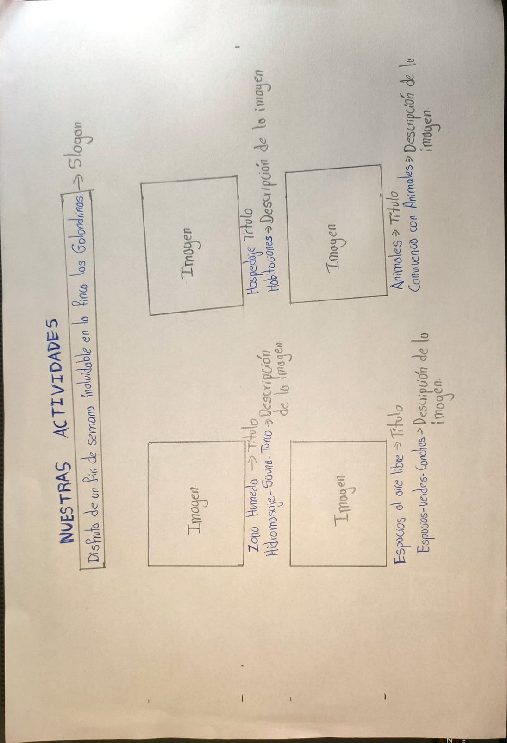

Slide 6
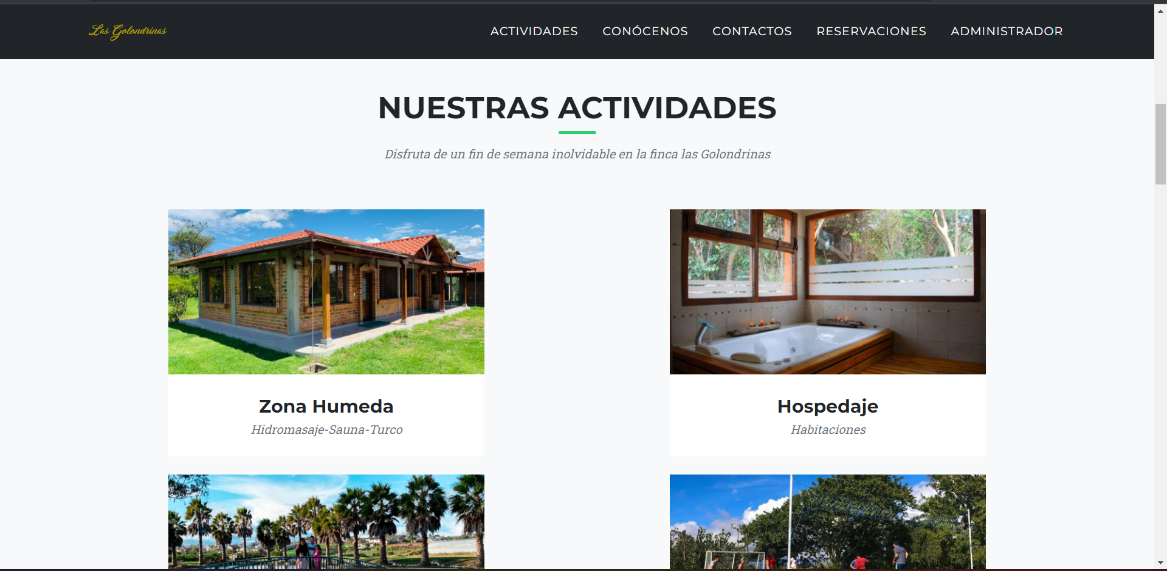

Slide 7
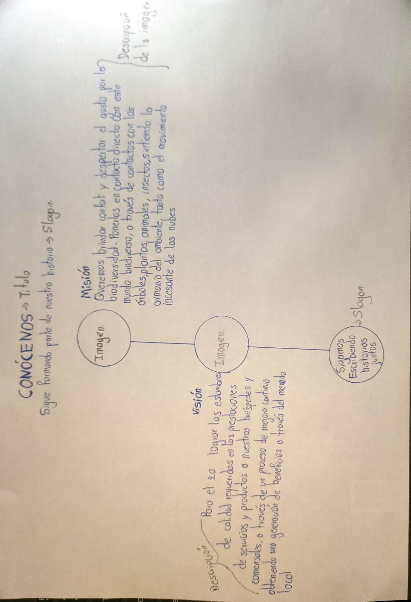

Slide 8
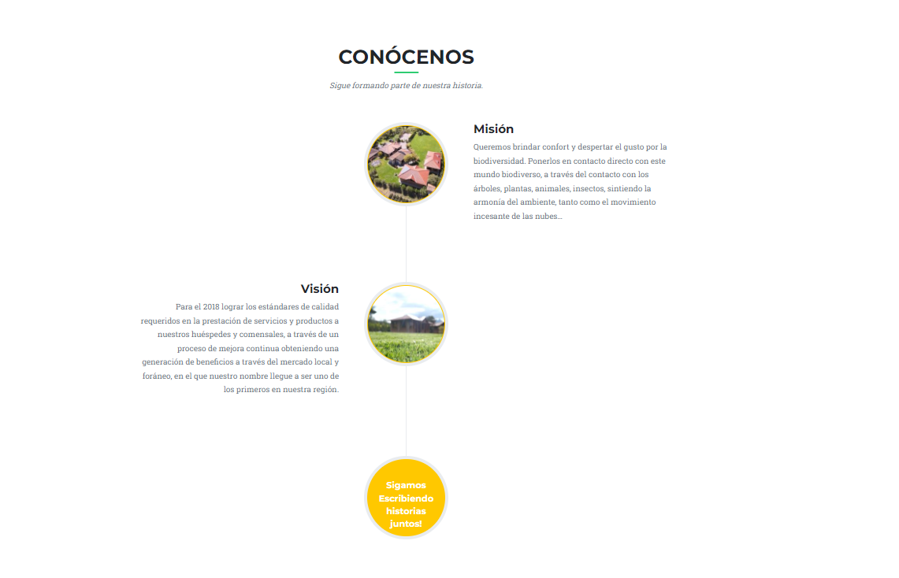

Slide 9
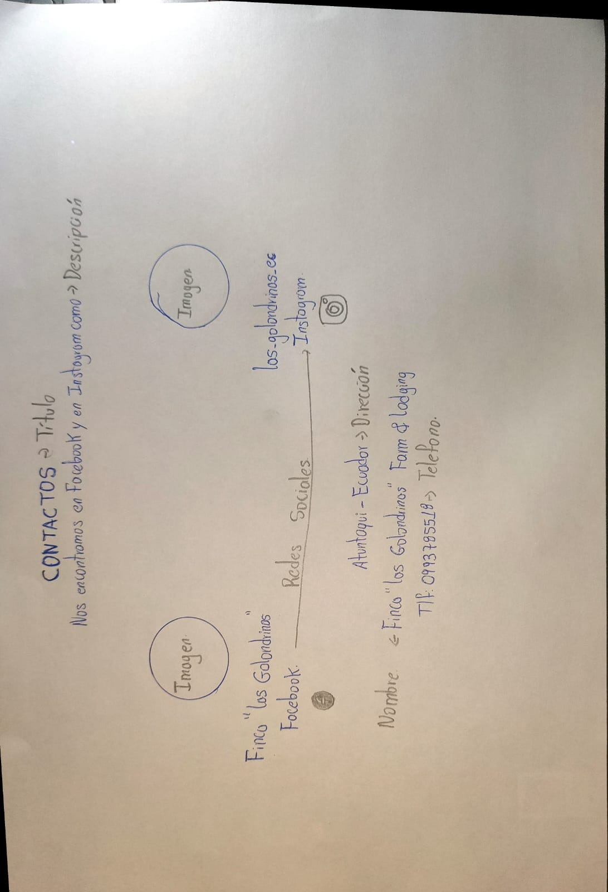

Slide 10
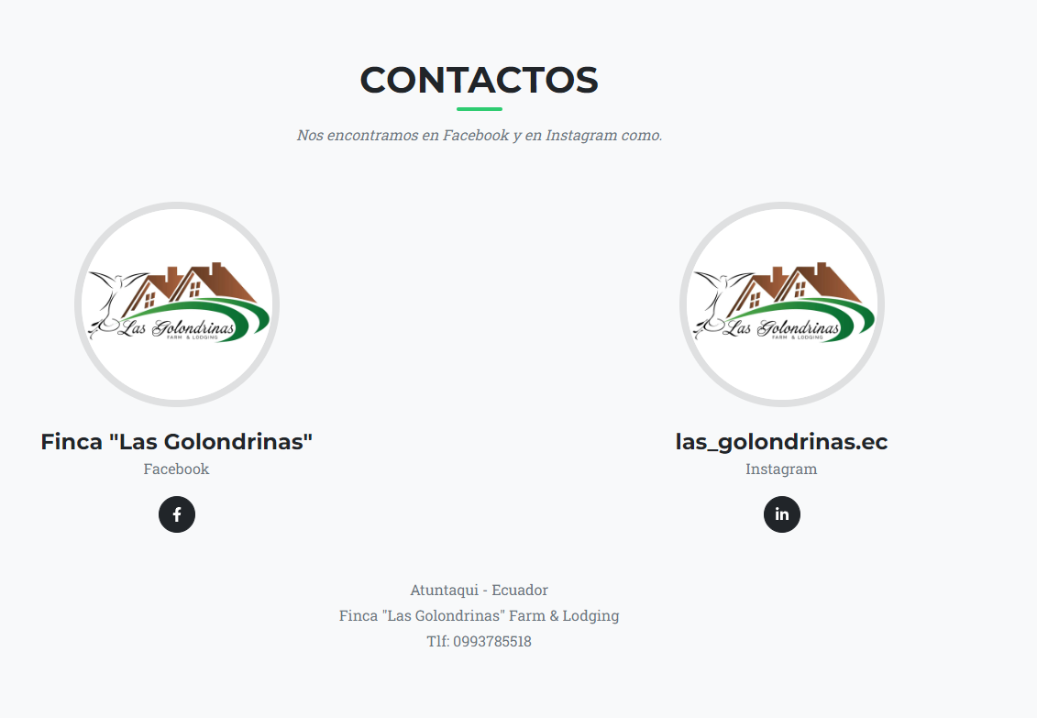

Slide 11
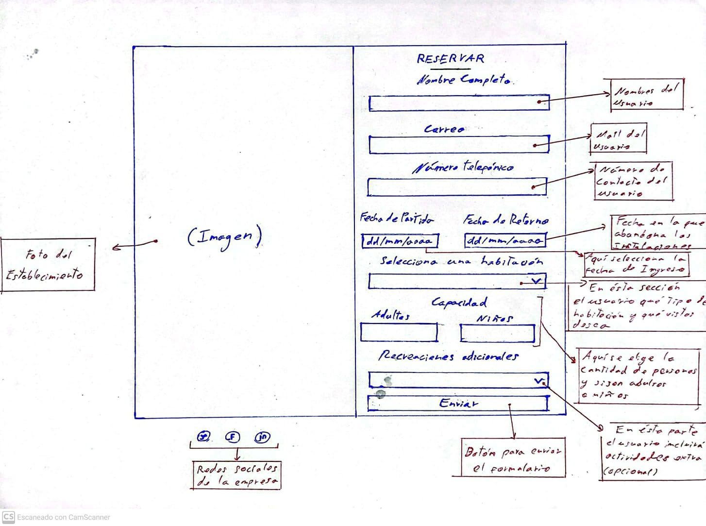

Slide 12
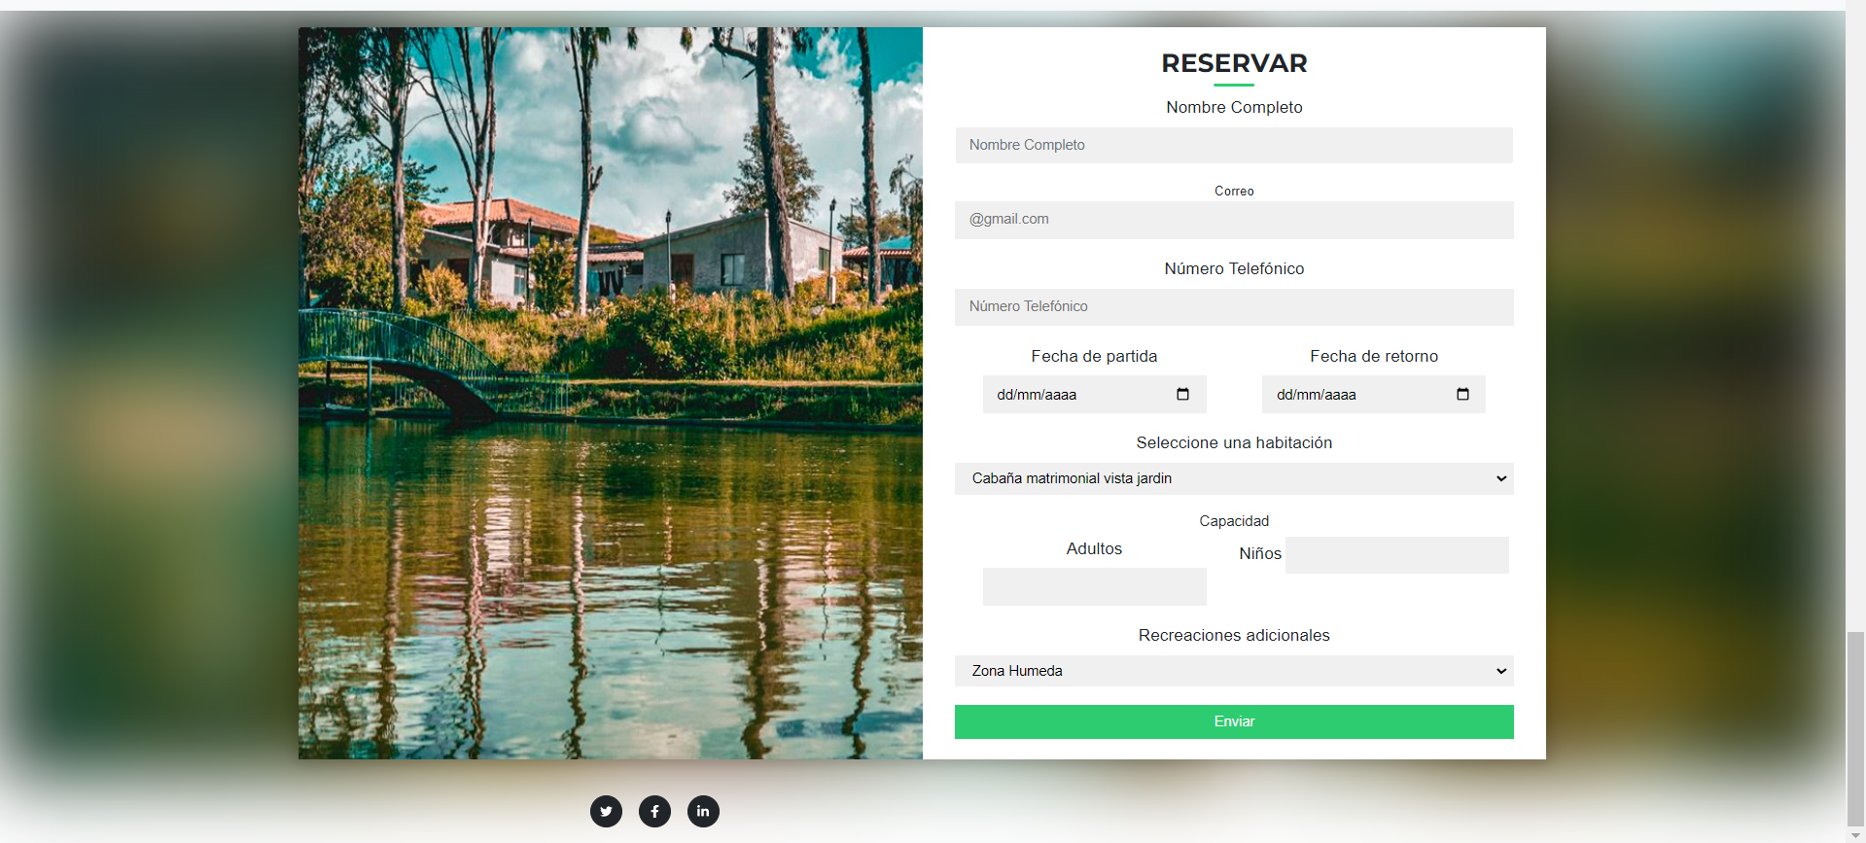

Slide 13
Architecture

Slide 14
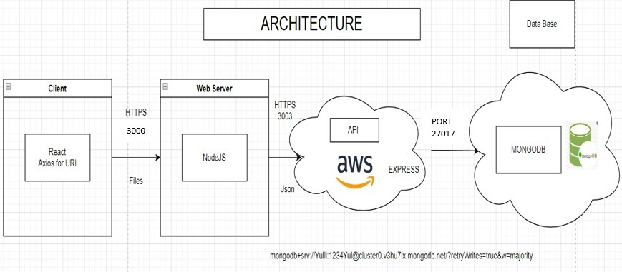

Slide 15
UML

Slide 16
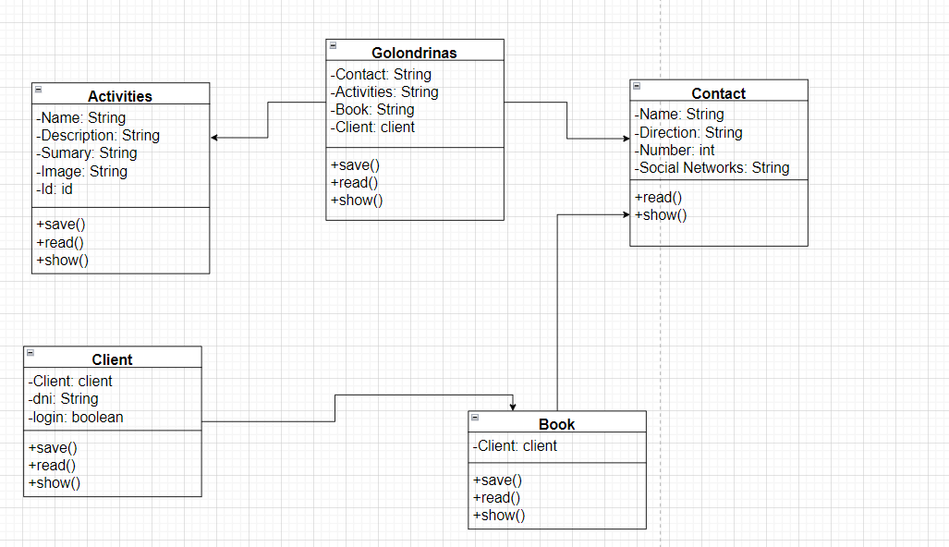

Slide 17
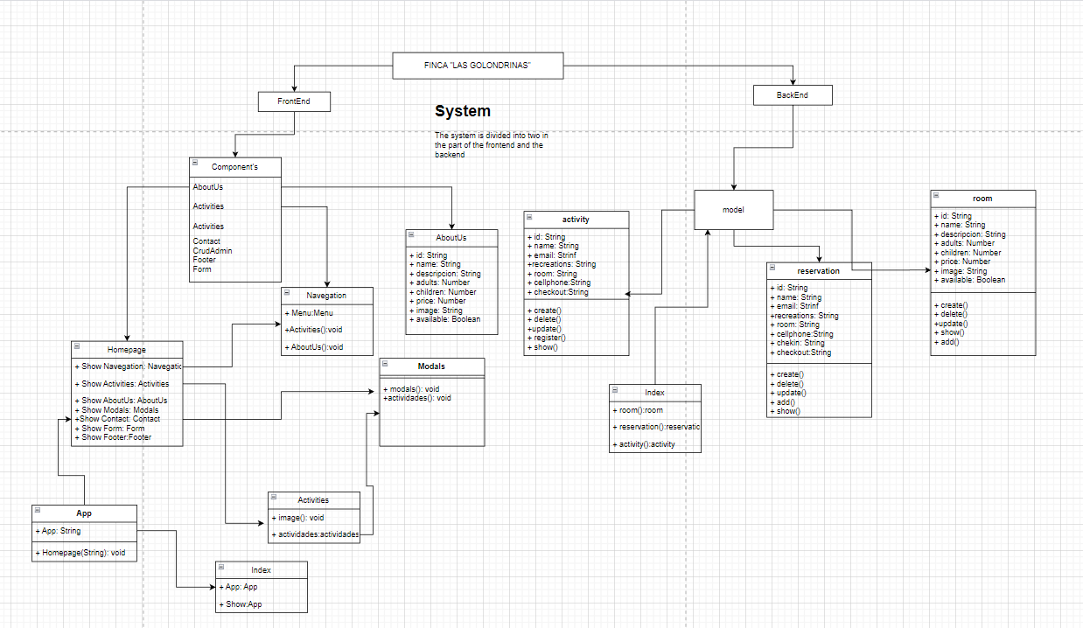

Slide 18
Navigation

Slide 19
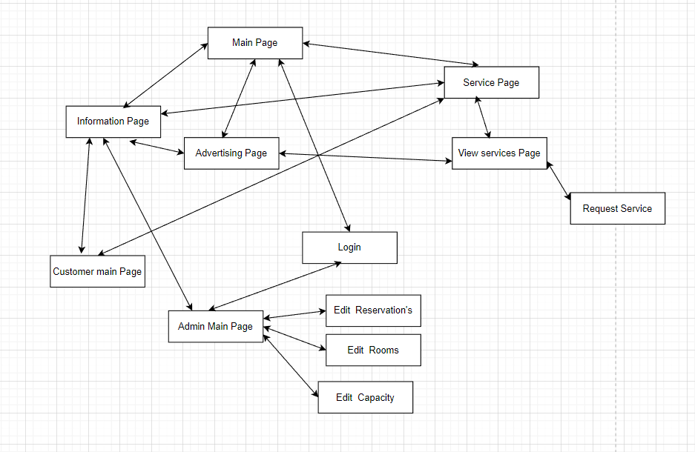

Slide 20
CONCLUSIONS AND RECOMENDATIONS

Slide 21
Understanding the business model is an important challenge since the begin. Analyze and study the architecture to develop the entire project. Keep in touch with the Product Owner.

